Slide 1



HR Data Analytics
View in Power BI
Last data refresh:
1/25/2024 4:25:50 PM UTC
Downloaded at:
1/25/2024 4:26:53 PM UTC

Slide 2
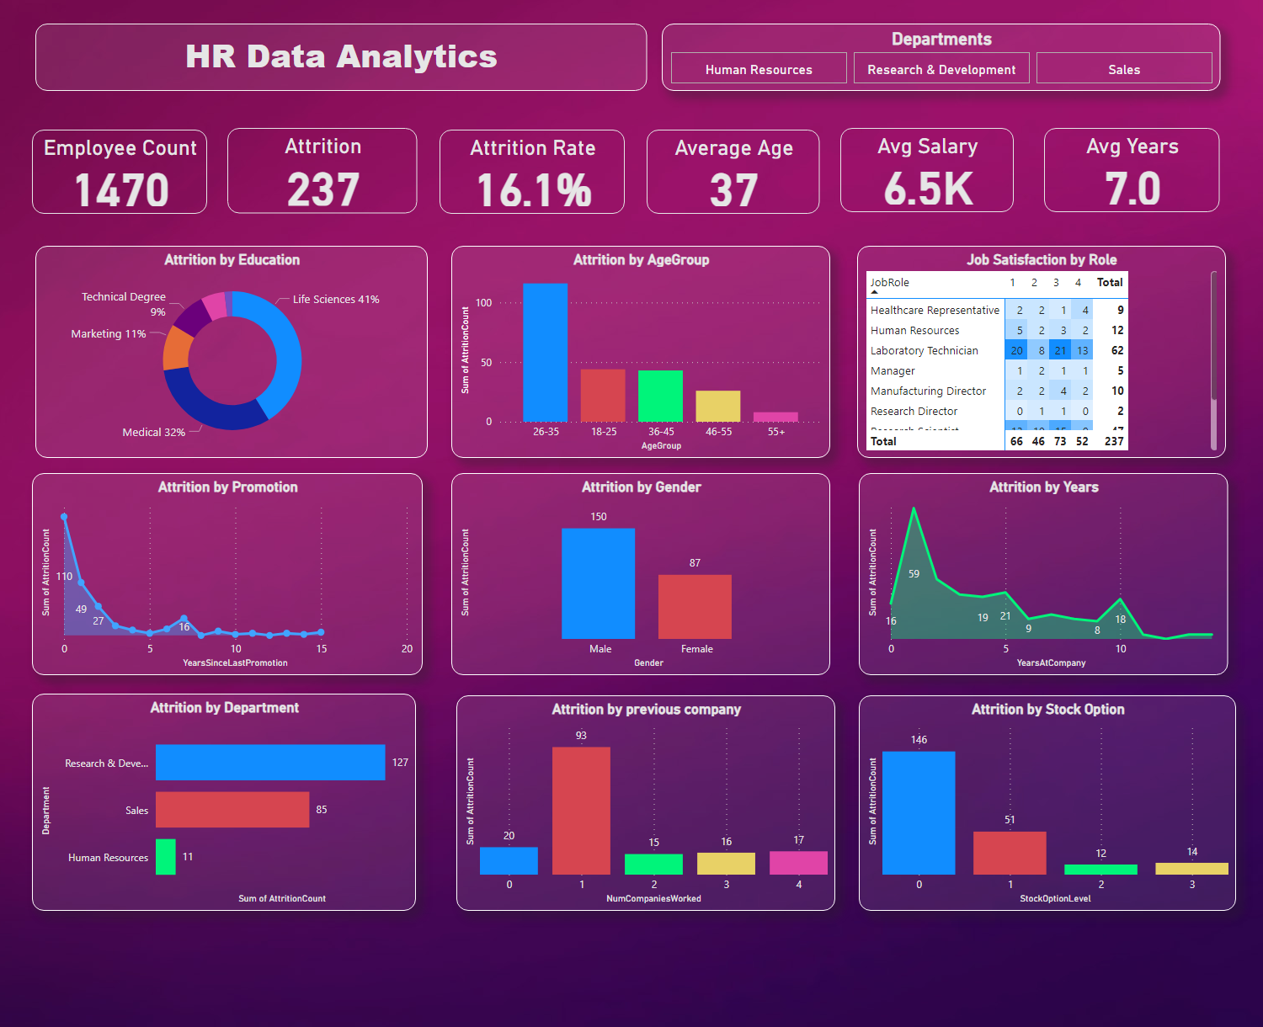
Page 1
Notes:
Employee Count
No alt text provided
Attrition
No alt text provided
Attrition Rate
No alt text provided
Average Age
No alt text provided
Avg Salary
No alt text provided
Avg Years
No alt text provided
Attrition by Education
No alt text provided
Attrition by AgeGroup
No alt text provided
Job Satisfaction by Role
No alt text provided
Attrition by Promotion
No alt text provided
Attrition by Gender
No alt text provided
Attrition by Years
No alt text provided
Attrition by Department
No alt text provided
Attrition by previous company
No alt text provided
Attrition by Stock Option
No alt text provided
Departments
No alt text provided
textbox
No alt text provided

